Slide 1
Robot Raconteur Training Seminar
Day 3
John Wason, Ph.D.
Wason Technology, LLC
16 Sterling Lake Rd, Tuxedo, NY, 10987
wason@wasontech.com

Slide 2
RR Events
RR events are a method for a service to notify the client of something
When an event is fired every client connected to the service is notified at once
The parameters of the event are passed to the client with the firing of the event
Events are defined similar to functions in Robdefs and connected to a receiving function

Slide 3





Declaration of RR Events
Robdef Event Definition
Robdef Event Service Instantiation
Robdef Event Client Function

Slide 4
RR Sending Data
Because there are many different kinds of sensors and interfaces that RR needs to work with, RR has a number of ways to transmit data
Some devices even contain multiple kinds of different sensors that all need to transmit data on unique channels
For continuous data feeds there are two main options: Pipes and Wires

Slide 5
Pipes Vs. Wires
Pipes
Wires
First In First Out data sending
Indexed for each client
Bidirectional
Packets are received in the order they were sent
Use RR data types to send data
Can be checked for availability
Can be closed by client or service
Most recent data sending
Not indexed for each client
Bidirectional
Packets can be lossy, data sending does not hang
Use RR data types to send data
Can have the timestamp of last data checked
Is not closed by client

Slide 6
Explanation of Pipes
Pipes represent full duplex first in first out communication
Pipes CANNOT lose packets, if they do the connection will hang, unless it has the modifier unreliable
Pipes use something called PipeEndpoint pairs between each client and service, data sent on one endpoint appears as received in the corresponding endpoint
An endpoint can request acknowledgement of a packet being received to verify the integrity of the transmission

Slide 7
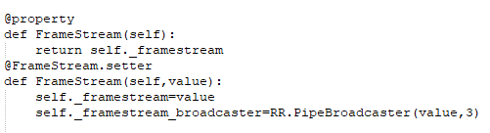

Declaration of Pipes
Robdef Pipe Definition
RR Pipe Service Definition
pipe WebcamImage FrameStream
Pipes are initialized as follows:
Values are sent through pipes as follows:
Values are received through pipes as follows:

Slide 8
Explanation of Wires
Wires are similar to pipes except they only return the most recently sent values
Wires are designed as the basis of real-time systems since they are faster than pipes
Wires also work well with lossy channels where data might be lost unexpectedly
Each packet sent has a timestamp when it was sent from the sender’s clock
WireConnection pairs are different than PipeEndpoint pairs in that the service only has one endpoint no matter how many clients connect

Slide 9

Declaration of Wires
Robdef Wire Definition
RR Wire Service Definition
wire SensorPacket packets
Values are sent through Wires as follows:
Values are received through Wires as follows:

Slide 10
Wire Peeking and Poking
Wire clients can peek and poke values of a wire as well
Peek and Poke read the value synchronously without requiring a streaming connection to the wire
PeekInValue can be used to read the InValue
PeekOutValue can be used to read the current OutValue from the client
PokeOutValue can be used to send a single message along the output wire

Slide 11
Robot Raconteur Generators
Modeled after Python Generators, RR functions can return or take in these generators
Generators are useful for long running operations or to return large amounts of data
There are 3 different forms of Generators:
Each iteration of the Generator takes a parameter and returns a value
Each iteration of the Generator returns a value
Each iteration of the Generator takes a parameter

Slide 12
Robot Raconteur Generator Examples
Generator Type 1
function double{generator} addManyNumbers(int32 a, double{generator} b)
Generator Type 2
function double{generator} getSequence(int32 a, double b)
Generator Type 3
function void accumulateNumbers(double{generator} b)

Slide 13
Using Robot Raconteur Generators
In Generator type 1 an initial parameter a can be sent with the function call, while the generator object b can be sent iteratively using b.Next(), then each iteration of the output is received by calling .Next() on the returned value
In Generator type 2, the next value in the function is returned using .Next() on the returned value
In Generator type 3 the function must return void, each call to .Next() must receive a parameter

Slide 14
Additional Info on Generators
Generators when they have finished will throw StopIterationException or OperationAbortedException
These signal that the generator object should be destroyed
Generator clients must call Close or Abort on the generator if no exception is reached
Generators that represent long running operations should return from Next every 10 seconds at least to prevent timeout errors

Slide 15
UUIDs and How to Use Them

Slide 16
RR Transport Levels
RR encapsulates 3 different transport types:
TcpTransport: for communication over TCP/IP networks
LocalTransport: for communication between nodes on the same computer
HardwareTransport: for communication over things like Bluetooth, USB and PCIe
The transport type is determined in the URL of the service when it is started as seen here:
rr+tcp://localhost:62354?service=Create

Slide 17
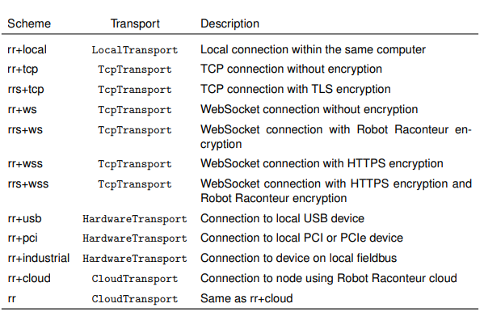
RR URL Schemes

Slide 18
Robdef Service Trees
When using RR standardized Robdefs or when the Robdef used refers to other Robdefs those must be registered to the service as well
So to use a standardized robot raconteur sensor interface you must include all the robdefs imported by that robdef
For example, to use com.robotraconteur.geometry you must register com.robotraconteur.identifier and com.robotraconteur.identifier relies on com.robotraconteur.uuid which must also be registered

Slide 19
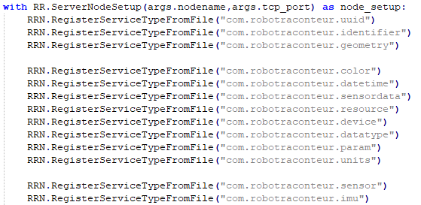
Example Robdef Service Tree

Slide 20
RR Exclusive Object Locks
Because RR services allow multiple clients to connect to them it is possible that multiple clients will call the same function or try to access the same data
This would be extremely problematic, but RR provides the ability to lock functions similar to Python Threading locks
There are three types of RR Locks:
User Locks
Client Locks
Monitor Locks

Slide 21
User Exclusive Object Lock
The user lock locks an object in the service to a specific username
The user client must be authenticated and have the objectlock privelege
The lock works on any object and the objects below the current object in the objref tree
Locks can be created using:
RRN.RequestObjectLock(obj, RR.RobotRaconteurObjectLockFlags_USER_LOCK)
Locks can be released using:
RRN.ReleaseObjectLock(obj)
Privileges can override these locks, locks also cannot stop wires and pipes currently connected

Slide 22
Client Exclusive Object Lock
The Client object lock is identical to the User lock except that it only allows ONE unique client connection, independent of username
Though more restrictive this means that if the Client needs to be restarted without releasing the lock the service must be restarted as well
Client object locks are created using:
RRN.RequestObjectLock(obj, RR.RobotRaconteurObjectLockFlags_CLIENT_LOCK)

Slide 23
Monitor Exclusive Object Lock
Monitor object lock gives a global thread monitor lock (mutex) on a single object
Designed for short term operations that will time out after a maximum of 15 seconds
Unlike User and Client, Monitor locks must be implemented by the object being locked
Implemented in client as:
with RR.RobotRaconteurNode.ScopedMonitorLock(obj):

Slide 24
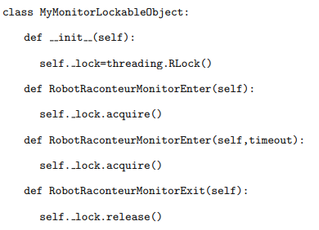
Monitor Exclusive Object Lock Service Object Example

Slide 25
Closing Services and Clients
In closing services or clients it is important to call Close() on any active Wire or Pipe.
Usually Services should be made to close Wires and Pipes on a keypress or in the event of an error being thrown
Clients should close Pipe connections from their end but do not need to close Wires if another client is meant to reconnect

Slide 26

RR Node Auto Discovery
RR nodes can be found using the type of the root object service
The line in a service definition that announces the service as available is:
This initializes the auto-discovery system to send out beacon packets so that clients can identify and connect to the service
Over TCP a UDP packet is sent every ~55 seconds to announce they are available

Slide 27
RR Subscriptions
Subscriptions are an extension of node auto discovery that automatically form connections to detected nodes
A subscription is created using the SubscribeClients function which takes a list of service types and an optional ServiceSubscriptionFilter
Object returned from this function can be used to retrieve the connected services
The GetConnectedClients function returns a dictionary of all connected clients, the keys contain the node IDs and the service names of them, the value is the client object reference
The ClientConnected and ClientDisconnected events can be used to monitor client connections

Slide 28
RR Subscriptions (continued)
Wires and Pipes can be subscribed to once a ServiceSubscription is created
SubscribeWire takes the name of the member and returns a WireSubscription that can be used to interact with all connected wires. The InValue read is the most recent from ALL connected wires
Same form is used for pipes, but all packets are not sorted and received together and are retrieved FIFO
SendPackets on a PipeSubscription sends packets to all connected pipes
These subscriptions can only be made to root objects and cannot be used from Objects retrieved by object references

Slide 29

RR Authentication
Robot Raconteur has a built-in authentication system
During connection, a client can specify a username of type “string”, and credentials of type “varvaluestring”
A connection client example is shown here:
Services need to create a UserAuthenticator and load in the contents of an MD5 file containing acceptable passwords

Slide 30
RR Authentication:
Password File Creation
First create a simple .txt file with the following format, username MD5_hashed_password priveleges
As seen here:
To create the MD5_hashed_passwords use the following command in console:

Slide 31


RR Authentication:
Service Side
In the service a PasswordFileUserAuthenticator should be made as shown:
Then a ServiceSecurityPolicy should be created as follows:
The service can then be started as follows: RRN.RegisterService("Create","experimental.create.Create",obj, s)

